Slide 1

KDD Project Presentation
Team members:
Sampath Kumar Gunasekaran
Nitish Rangarajan
Yuvaraj Sundarrajan
Ajay Kumar Prathap
Shrutha Kashyap

Slide 2
PROBLEM STATEMENT
A managed healthcare organization believes they suffer from over $30 million in preventable losses annually due to the readmission of patients who are discharged from the hospital too soon.
AIM: To develop a model of readmission risk that doctors can consider when determining when to discharge a patient.

Slide 3

Correlation Analysis: Feature selection
The following attributes are used in relation to readmission attribute:
Race
Age
A1Cresult
Change in Medication

Slide 4
Correlation Analysis: Race
The first criterion considered was Race. The following correlation results were obtained by correlating race with readmission rates
Call: xtabs(formula = ~race + readmitted, data = patients)
Number of cases in table: 9772
Number of factors: 2
Test for independence of all factors:
Chisq = 58.37, df = 5, p-value = 2.644e-11
X^2 df P(> X^2)
Likelihood Ratio 60.077 5 1.1719e-11
Pearson 58.366 5 2.6439e-11
Phi-Coefficient : NA
Contingency Coeff.: 0.077
Cramer's V : 0.077

Slide 5
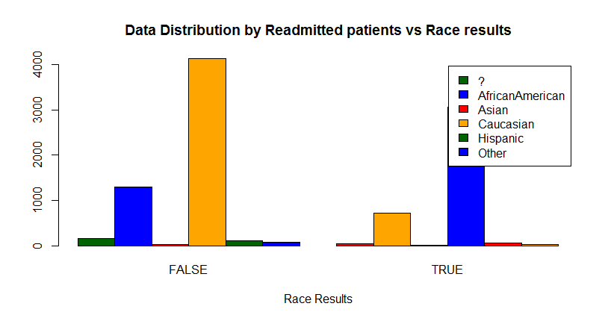
Bar-Plot for Race and Readmitted

Slide 6
Correlation analysis: Age
The second criterion considered was Age. The following correlation results were obtained by correlating age with readmission rates
Call: xtabs(formula = ~age + readmitted, data = patients)
Number of cases in table: 9772
Number of factors: 2
Test for independence of all factors:
Chisq = 100.81, df = 9, p-value = 1.078e-17
X^2 df P(> X^2)
Likelihood Ratio 104.77 9 0
Pearson 100.81 9 0
Phi-Coefficient : NA
Contingency Coeff.: 0.101
Cramer's V : 0.102

Slide 7
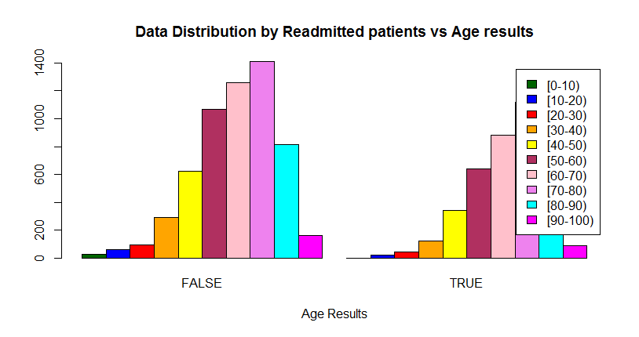

Slide 8
Correlation Analysis: HbA1C
The third criterion considered was HbA1C. The following correlation results were obtained by correlating HbA1C with readmission rates
Call: xtabs(formula = ~A1Cresult + readmitted, data = patients)
Number of cases in table: 9772
Number of factors: 2
Test for independence of all factors:
Chisq = 8.836, df = 3, p-value = 0.03156
X^2 df P(> X^2)
Likelihood Ratio 8.9155 3 0.030436
Pearson 8.8358 3 0.031556
Phi-Coefficient : NA
Contingency Coeff.: 0.03
Cramer's V : 0.03

Slide 9
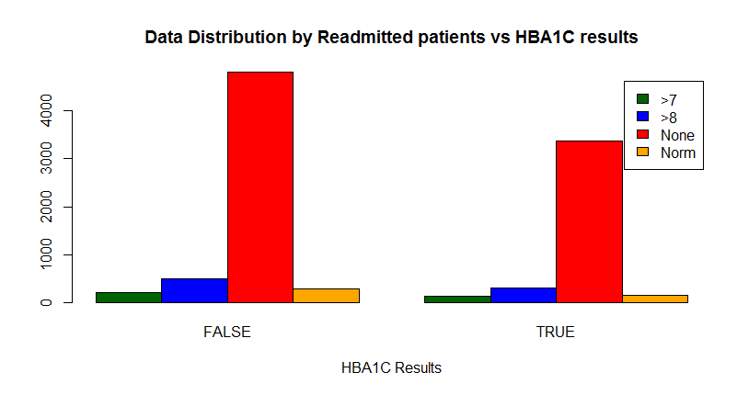

Slide 10
Correlation analysis: Change in Medication
The third criterion considered was change in Medication. The following correlation results were obtained by correlating change in medication with readmission rates
Call: xtabs(formula = ~change + readmitted, data = patients)
Number of cases in table: 9772
Number of factors: 2
Test for independence of all factors:
Chisq = 22.304, df = 1, p-value = 2.327e-06
X^2 df P(> X^2)
Likelihood Ratio 22.276 1 2.3612e-06
Pearson 22.304 1 2.3268e-06
Phi-Coefficient : 0.048
Contingency Coeff.: 0.048
Cramer's V : 0.048

Slide 11
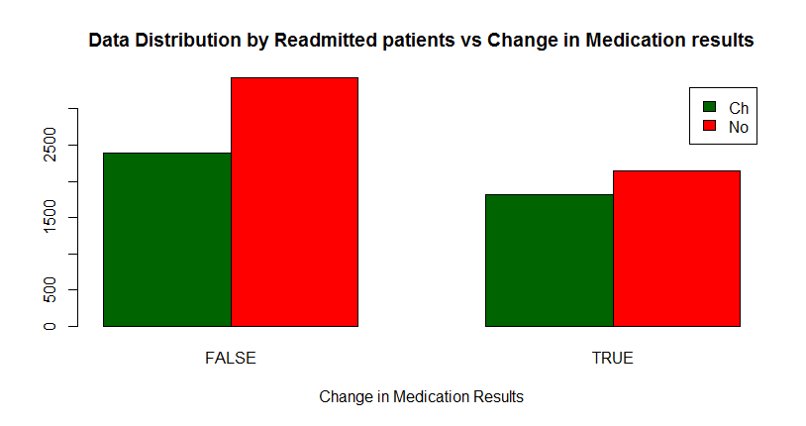

Slide 12
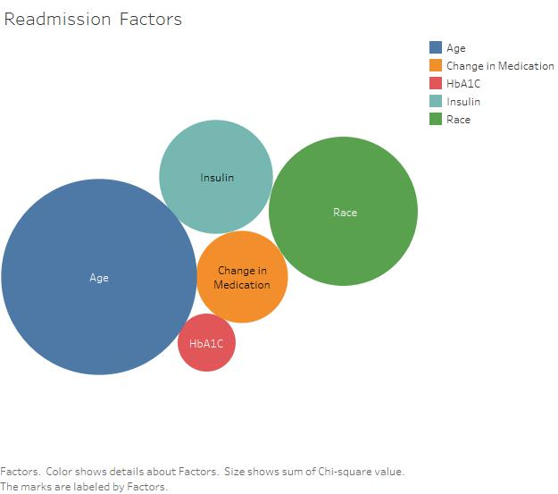
Correlation summary
The visualization is performed based on the p value. Hence smaller the bubble size, greater the impact it has on the readmission predictive model.

Slide 13
Task 1
How insulin and change in medication affects HbA1C result. WHY? This task helps prevent early readmission indirectly by monitoring the administration of medication and insulin levels that affect the HbA1C result. Some patients may choose not to take the HbA1C tests. Hence we could use insulin and change in medication to predict readmission. TECHNIQUES: Correlation test, Multivariate multiple regression.

Slide 14
Regression analysis
Linear regression was run on the readmission data to determine which of the input components influences model the most.
The following regression models were developed:
Predicting the linear relationship between readmission rate(dependent variable) and HbA1C result (independent variable)
Predicting the linear relationship between readmission rate (dependent variable) and HbA1C result, insulin (independent variables)
Predicting the linear relationship between readmission rate (dependent variable) and HbA1C result, insulin, change in medication (independent variables)

Slide 15
Linear Regression Analysis
Linear Regression statistics were run between readmission rate and HbA1C
The following regression results were obtained
Regression Results:
Call: lm(formula = readmitted ~ A1Cresult, data = patientData) Residuals: Min 1Q Median 3Q Max -0.4105 -0.4105 -0.3970 0.5895 0.6299 Coefficients: Estimate Std. Error t value Pr(>|t|) (Intercept) 0.423960 0.009052 46.835 <2e-16 *** A1Cresult -0.013472 0.005537 -2.433 0.015 * --- Signif. codes: 0 ‘***’ 0.001 ‘**’ 0.01 ‘*’ 0.05 ‘.’ 0.1 ‘ ’ 1 Residual standard error: 0.4909 on 9770 degrees of freedom Multiple R-squared: 0.0006055, Adjusted R-squared: 0.0005032 F-statistic: 5.919 on 1 and 9770 DF, p-value: 0.01499

Slide 16
Linear Regression Analysis
Linear Regression statistics were run between readmission rate and HbA1C, insulin
The following regression results were obtained
Regression Results:
Call: lm(formula = readmitted ~ A1Cresult + insulin, data = patientData)
Residuals: Min 1Q Median 3Q Max -0.4287 -0.4026 -0.4026 0.5887 0.6410
Coefficients: Estimate Std. Error t value Pr(>|t|) (Intercept) 0.408355 0.012294 33.215 < 2e-16 ***
A1Cresult -0.014524 0.005565 -2.610 0.00907 ** insulin 0.008718 0.004648 1.876 0.06074 . ---
Signif. codes: 0 ‘***’ 0.001 ‘**’ 0.01 ‘*’ 0.05 ‘.’ 0.1 ‘ ’ 1
Residual standard error: 0.4908 on 9769 degrees of freedom
Multiple R-squared: 0.0009652, Adjusted R-squared: 0.0007607
F-statistic: 4.719 on 2 and 9769 DF, p-value: 0.008942

Slide 17
Linear Regression Analysis
Linear Regression statistics were run between readmission rate and HbA1C, insulin, change in medication
The following regression results were obtained
Regression Results:
Call: lm(formula = readmitted ~ A1Cresult + change + insulin, data = patientData) Residuals: Min 1Q Median 3Q Max -0.4415 -0.3905 -0.3883 0.5766 0.6593 Coefficients: Estimate Std. Error t value Pr(>|t|) (Intercept) 0.407491 0.012283 33.175 < 2e-16 *** A1Cresult -0.015853 0.005567 -2.848 0.00441 ** change 0.050984 0.011075 4.604 4.2e-06 *** insulin -0.001127 0.005112 -0.221 0.82544 --- Signif. codes: 0 ‘***’ 0.001 ‘**’ 0.01 ‘*’ 0.05 ‘.’ 0.1 ‘ ’ 1 Residual standard error: 0.4903 on 9768 degrees of freedom Multiple R-squared: 0.003128, Adjusted R-squared: 0.002822 F-statistic: 10.22 on 3 and 9768 DF, p-value: 1.029e-06

Slide 18
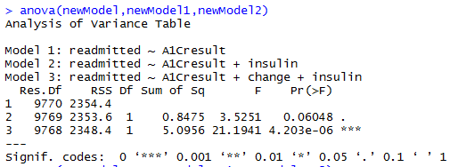
ANOVA test
ANOVA test was run on the above three models to determine which of the above three models fits the best.

Slide 19
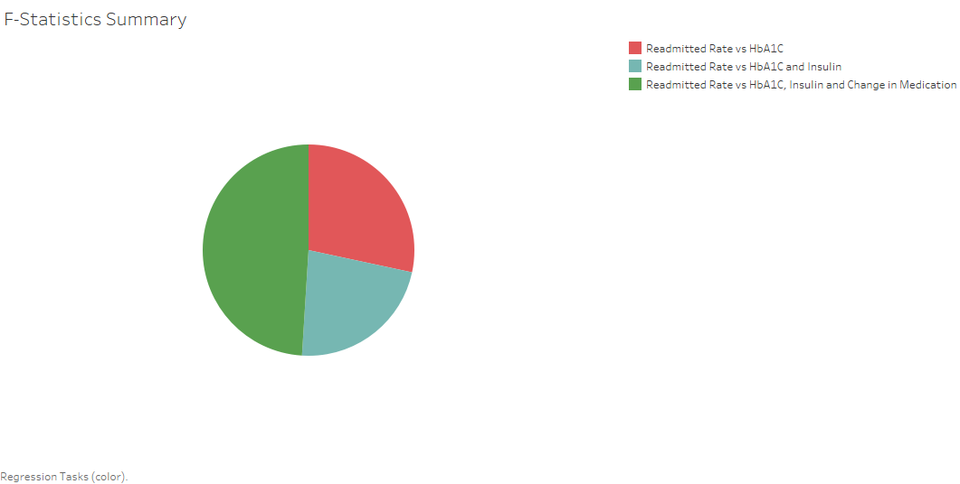
Regression Results summary
The results indicate a high F statistics for the third model(between readmission rate and HbA1C, insulin, change in medication). This means that the variance of readmission rate across the different model is much larger than within the same model.
Also, the third model has the lowest p-value, much less than 0.05.
Hence, we can conclude that for our confidence interval we accept the alternative hypothesis that there is a significant relationship between insulin, change in medication ,HbA1C , and readmission.

Slide 20
Task 2
Predicting the likelihood of a non-diabetic patient (say Circulatory disorder) going for a secondary/diabetes diagnosis. WHY? The likelihood of a patient being readmitted is high when a patient has both circulatory disorder as well as diabetes. So this helps us indirectly in predicting readmission rate. TECHNIQUES: correlation test, multivariate multiple regression.

Slide 21
Regression analysis
Linear regression was run on the readmission data to determine the relationship between a non-diabetic patient (say Circulatory disorder) going for a secondary/diabetes diagnosis. In turn, increasing the readmission rate.
The following regression models were developed:
Predicting the linear relationship between readmission rate(dependent variable) and secondary diagnosis as diabetes (independent variable)
Predicting the linear relationship between readmission rate (dependent variable) and primary diagnosis as circulatory disorder, secondary diagnosis as diabetes (independent variables)

Slide 22
Linear Regression Analysis
Linear Regression statistics were run between readmission rate and
Secondary diagnosis as diabetes
The following regression results were obtained
Regression Results:

Slide 23
Linear Regression Analysis
Linear Regression statistics were run between readmission rate and primary as circulatory, secondary as diabetes
The following regression results were obtained
Regression Results:

Slide 24
Regression Results summary
The results indicate a high F statistics for the second model(between readmission rate and primary as circulatory, secondary as diabetes). This means that the variance of readmission rate across the different model is much larger than within the same model.
Also, the second model has the lowest p-value, much less than 0.05.
Hence we can conclude that for our confidence interval we accept the alternative hypothesis that there is a significant relationship between a patient whose primary diagnoses is circulatory disorder and secondary diagnoses as diabetes increasing the re-admission rate for diabetes. Thus, we need to consider patients not only with diabetes but also with circulatory disorders in our predictive model, to reduce the re-admission rate.

Slide 25
Descriptive Statistics
Correlation Matrix & Descriptive Statistics

Slide 26
Principle Component Analysis
PCA test was run on the following three components: 1) A1Cresult 2) max_glu_serum 3) insulin

Slide 27
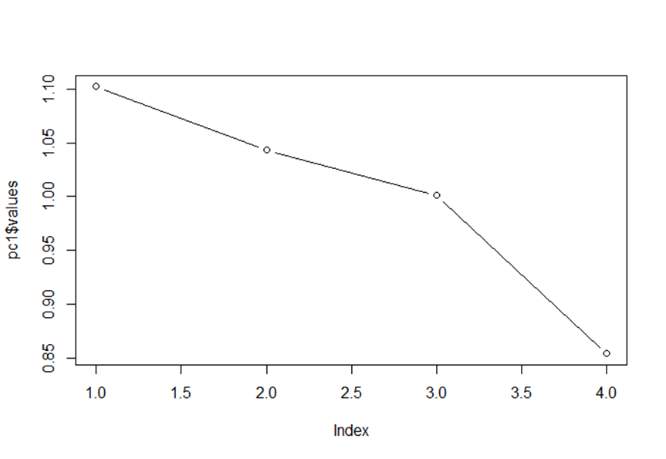
Scree Plot
Scree plot is used identify the point of inflexion
Resulting scree plot clearly shows that only the first factor (HbA1C) is significant

Slide 28
PCA results
From the results below we can conclude that HbA1C test factor has a great influence on readmission rate

Slide 29
PCA result Summary
Principal component model was created which extracted the above three factors. We can see all the eigen values associated with each factors. Factor1 (HbA1C result) explains 37% of the total variance.
Eigen Values
Hence, we can conclude that HbA1C test factor has a great influence on readmission rate

Slide 30
Additional Tasks:
How the discharge disposition affects change in medication and other factors. WHY? This task helps predict the patterns in insulin level, HbA1c test results and change of medication based on discharge disposition. TECHNIQUES: linear regression

Slide 31
INSIGHTS ABOUT DATA
The relationship between the probability of readmission and the HbA1C measurement significantly depends on the primary diagnosis being circulatory disorder. There was no significant interaction with other primary diagnosis.
Since gender was not significant in the core model without HbA1C it was removed from further analysis.
Our analysis cannot address cause and effect but the data provide strong support for development of protocol to examine the hypothesis directly.

Slide 32
FUTURE RESEARCH QUESTIONS
Do specific drugs or combinations of drugs increase the chances of readmission?
How does age play a role in the probability of readmission and/or outcomes?
Does the number of procedures, medication, and lab procedures correlate with either the readmission probability or the likelihood that the HbA1c test is performed?
Do the drugs’ dosage information be carefully examined and find out if it acts as significant predictors for readmission rate.

Slide 33
THANK YOU!

